Slide 1
Relationships and Sexuality Education (RSE)
Cwrt Rawlin Primary School

Slide 2
Welsh Government believes…
..all children and young people have the right to receive high-quality, holistic and inclusive education about relationships and sexuality.
help increase learners’ understanding of and participation in healthy, safe, and fulfilling relationships
help young people recognise abusive or unhealthy relationships and seek support
help reduce all bullying, including homophobic, biphobic and transphobic bullying, and increase safety and well-being for all learners
help all learners make informed decisions about sexual intimacy and reproductive health
help promote equality and equity of sex, gender and sexuality
increase awareness, knowledge and understanding of gender-based and sexual violence

Slide 3
RSE Code of Practice
Relationships and Sexuality Education (RSE) is a statutory requirement in the Curriculum for Wales framework and is mandatory for all learners from ages 3 to 16.
https://hwb.gov.wales/curriculum-for-wales/designing-your-curriculum/cross-cutting-themes-for-designing-your-curriculum/

Slide 4
RSE Curriculum
This mandatory RSE Code supports schools to design their RSE. The content is set within the context of broad and interlinked learning strands, namely:
relationships and identity
sexual health and well-being
empowerment, safety and respect
Phase 1 – Foundation Phase (up to age 7)
Phase 2 – Key Stage 2 (up to age 11)
Phase 3 – Key Stage 3 (up to age 16)
*Children develop at different rates and practitioners take account of everything they know about a learner’s cognitive, social and emotional development when introducing RSE strands.

Slide 5
Links to the Curriculum – Health & Wellbeing Area of Learning Experience
WM3 – Our decision making impacts on the quality of our lives and others
(Learners make informed decisions regarding food and nutrition, personal care and hygiene, substance misuse, healthy relationships, personal safety [including online safety] careers and financial management.)
WM4 – How we engage with different social influences shapes who we are and our health and well-being
(This involves learners developing their own identity, resilience and values, and establishing links with the local community, wider communities and virtual communities/social groups, including an awareness of potential dangers.)
WM5 – Healthy relationships are fundamental to our sense of belonging and well-being
(This involves learners understanding relationships, e.g. friends, family, romantic, sexual, professional and spiritual. Learners develop skills to form and maintain positive relationships based on trust and mutual respect. Learners know how to manage conflict.)

Slide 6
Links to the Curriculum – Humanities and Science & Technology
Life-cycles and reproduction will continue to be taught through the science and technology Area, which along with other disciplines, draws upon the discipline of biology.

Slide 7
What will Primary children be taught?
https://www.youtube.com/watch?v=RG0XN4ccvWQ
Notes:
https://www.youtube.com/watch?v=RG0XN4ccvWQ

Slide 8
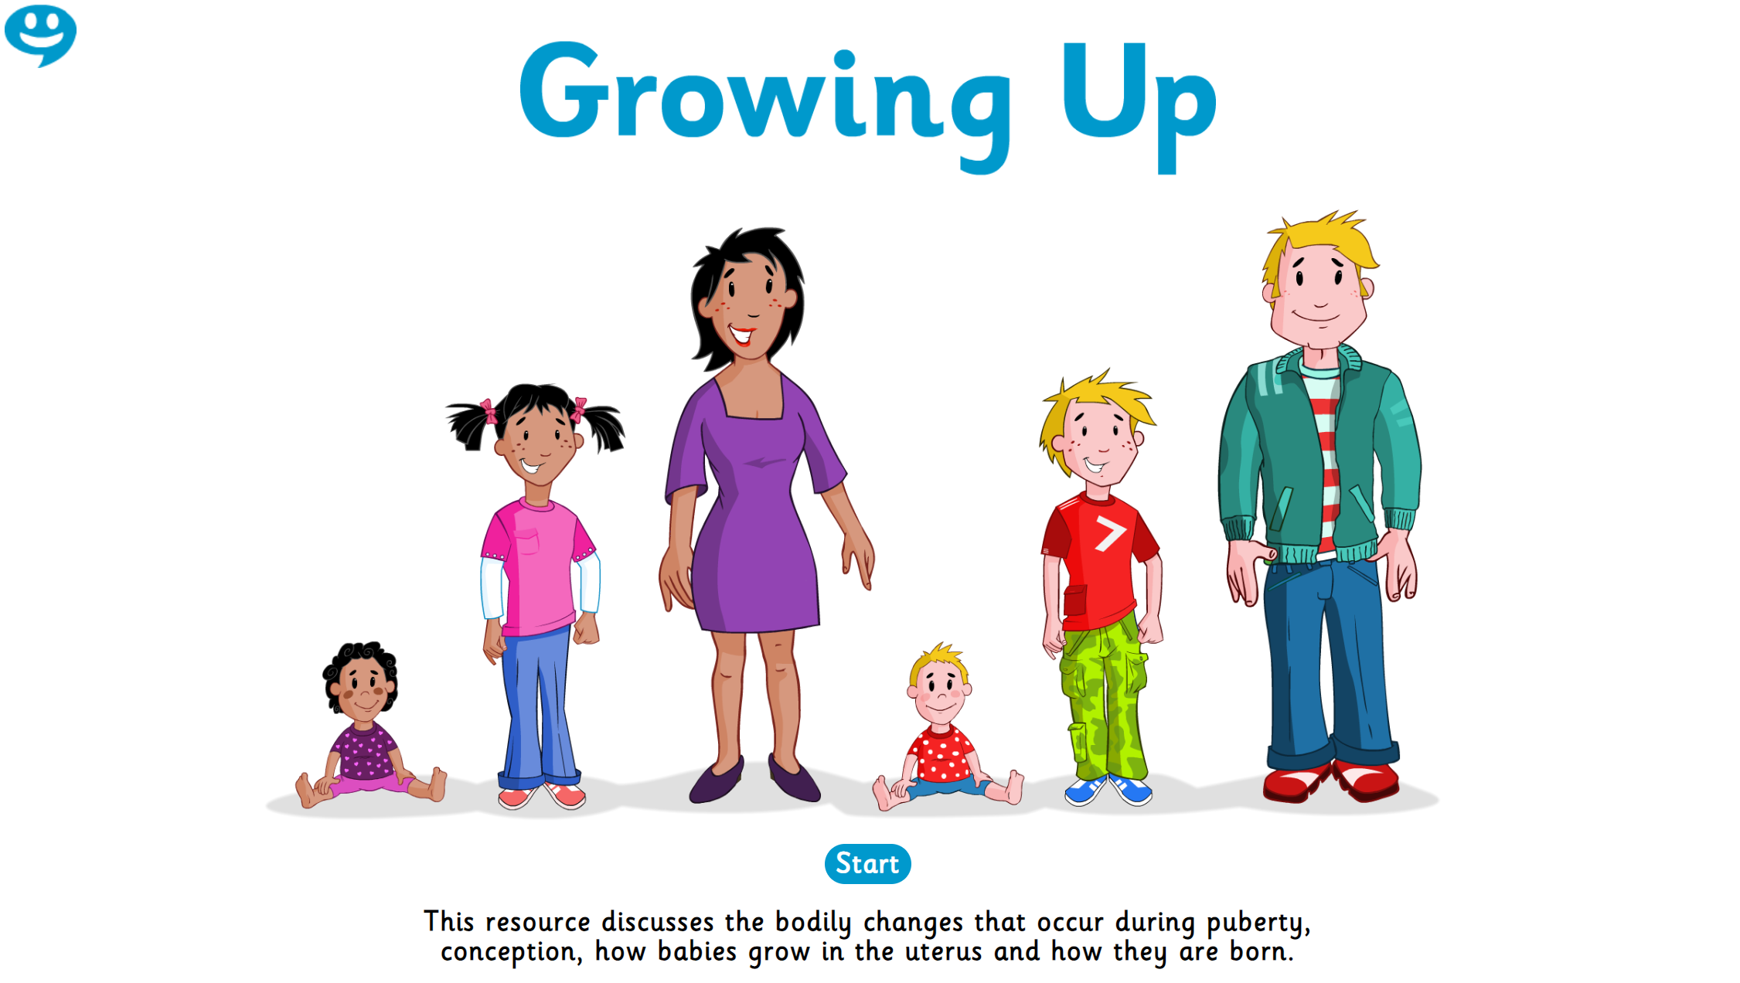
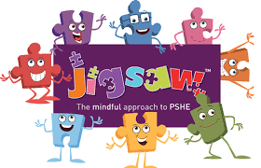
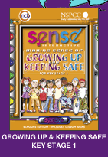
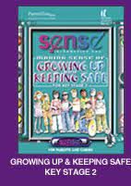
Resources to Support the RSE Curriculum
Growing Up (Hwb)
Jigsaw PSHE
Sense

Slide 9
What it is and what it’s not…
The new Relationships and Sexuality Education (RSE) Code – what it is and what it’s not! | Curriculum for Wales Blog (gov.wales)
… phases relate to ‘developmentally appropriate’ content. The learning set out in each phase indicates broadly when practitioners should start to consider whether learning in a phase is developmentally appropriate for their learners.
The Code does not promote, or actively encourage, any particular life-style choice, religious or values-based views, or specific activities; but aims to ensure that schools create safe and supportive learning environments’.

Slide 10
What it is and what it’s not…
The new Relationships and Sexuality Education (RSE) Code – what it is and what it’s not! | Curriculum for Wales Blog (gov.wales)
… ensure that they (the RSE strands) are covered from within the context of the Health and Wellbeing Area. This will ensure the positive and protective nature of RSE is realised through the lens of emotional wellbeing and healthy relationships.
Whereas learners in phase 3 of the RSE Code will learn about sexual health, young children and learners in early stages of development will learn about personal hygiene and how we keep ourselves clean.

Slide 11
What it is and what it’s not…
The new Relationships and Sexuality Education (RSE) Code – what it is and what it’s not! | Curriculum for Wales Blog (gov.wales)
… schools will be empowered to create their curriculum and whole-school approaches that are tailor-made for their pupils; ensuring that all learners can engage in RSE in ways that are appropriate, relevant and meaningful for them.
… schools will develop an RSE curriculum that truly reflects the experiences that our children and young people are having in the world around them.
…RSE will be designed in response to learners’ developing skills, knowledge, capacities and needs; as well as well as ensuring that they encounter RSE topics in away that is appropriate for their chronological age.

Slide 12
Communication with Parents
‘Communicating effectively with parents and carers on an ongoing basis is an important way to foster positive relationships in order to engage them in purposeful and meaningful dialogue.’
We will inform others of our RSE curriculum through the follow means;
School Website (RSE Policy, Curriculum Overview etc.)
School Prospectus
School Newsletter
Parents Curriculum Evening (early October 2022)

Slide 13
Case Study
https://www.youtube.com/watch?v=wozJBEBphGs
Notes:
https://www.youtube.com/watch?v=wozJBEBphGs

